Slide 1
Predicting Patient Medication Persistence using Random Forest Classifier
Name: Himani Aryan
Country: United Kingdom
Email:himani1689@gmail.com
Group: LISUM22
Specialization: Data Science

Slide 2
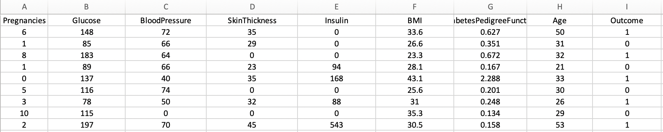
Problem Description: The challenge is to predict patient persistence in taking prescribed medications. This classification task aims to automatically identify patients likely to adhere to their prescribed medications, leading to improved patient outcomes, increased sales, and reduced healthcare costs.
Dataset: The dataset contains patient information such as pregnancies, glucose levels, blood pressure, skin thickness, insulin levels, BMI, diabetes pedigree function, age, and a binary outcome variable indicating medication persistence (1) or not (0).

Slide 3
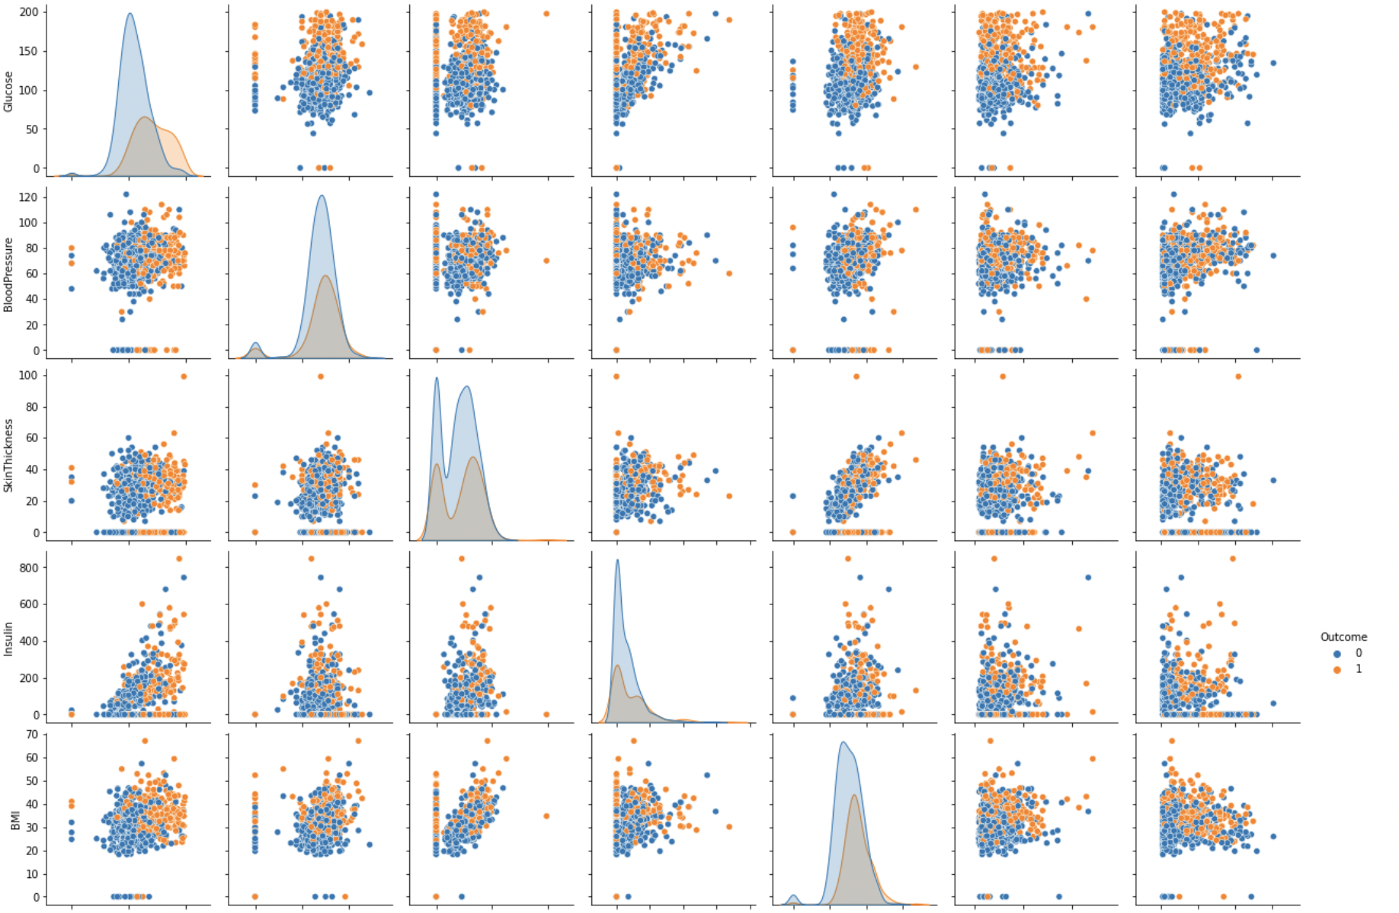
Analysis done on the data:
Pair plot visualises the relationships between numerical features (such as glucose levels, blood pressure, BMI, etc.) along with the 'Outcome' variable (medication persistence).
These visualizations offer valuable insights into how the numerical features are distributed in relation to the target variable "Outcome," which indicates whether a patient is persistent (1) or not (0) in taking prescribed medications
The pairplot's diagonal shows histograms for each numerical feature, helping us understand their individual distributions.
If the histogram for any particular feature shows that patients with higher levels of that feature have a greater frequency of medication persistence (Outcome 1), it suggests that higher levels might be associated with better medication adherence

Slide 4
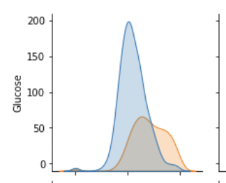
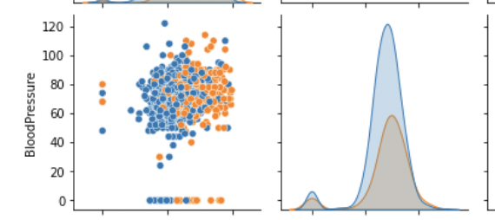
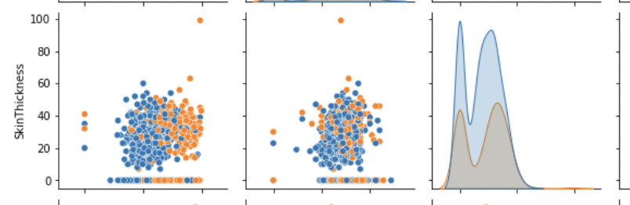
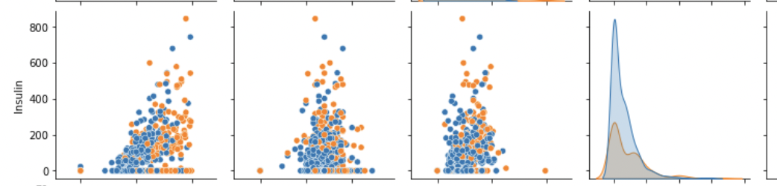
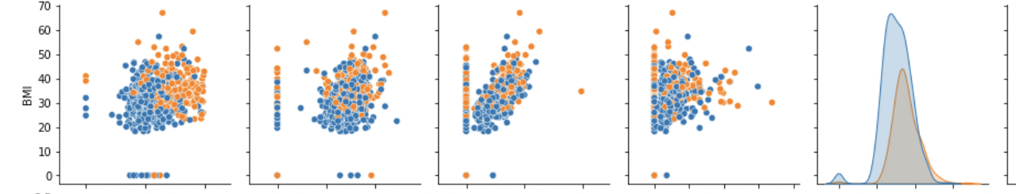
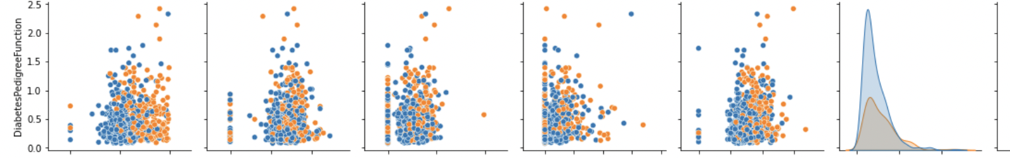
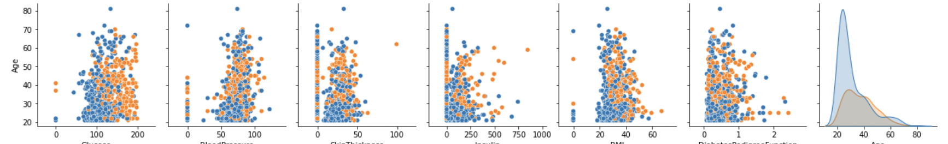
Conclusion from the plot
Conclusion: Glucose, Skin thickness, insulin, DiabetesPregnant function and Age feature shows that patients with higher levels of these features have a greater frequency of medication persistence (Outcome 1).
It suggests that higher levels of glucose, insulin might be associated with better medication adherence, along with more skin thickness and pregnant function. Age is also playing an important role here.

Slide 5
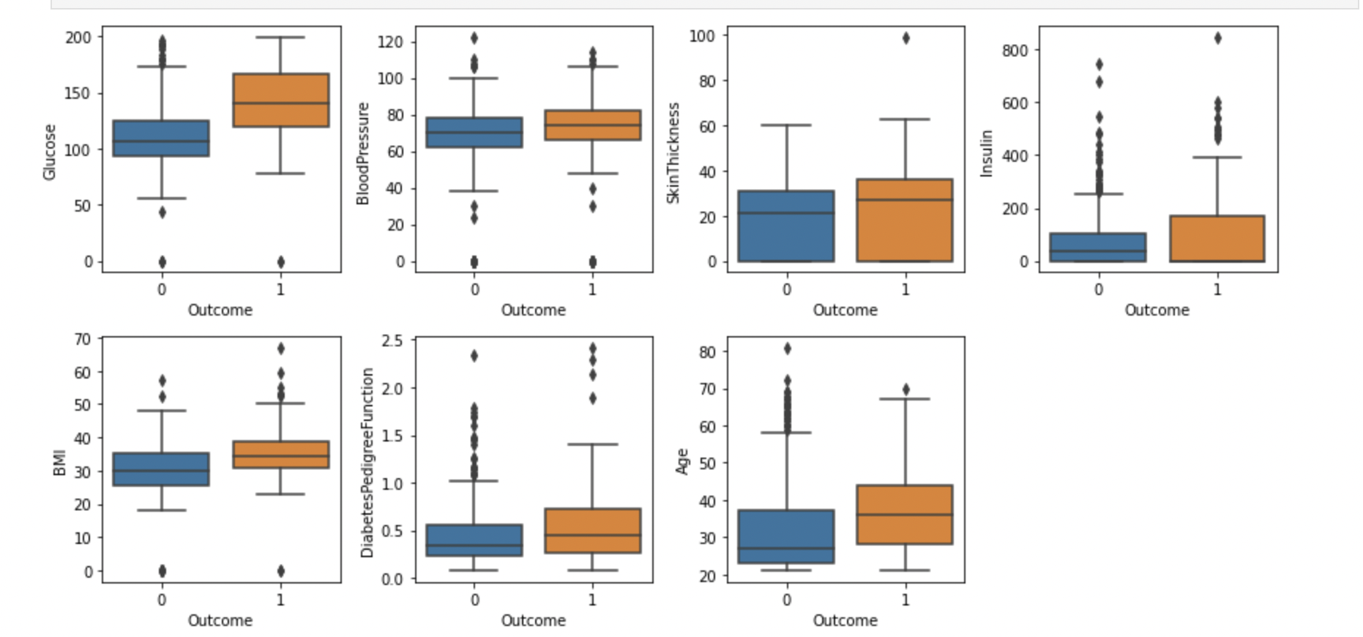
Box Plot Analysis
Glucose Levels: The boxplots show that patients with persistent medication adherence (Outcome 1) tend to have slightly higher median glucose levels compared to those who are not persistent (Outcome 0). This suggests that patients with higher glucose levels might be more inclined to follow their prescribed medication regimen.
Skin Thickness: The boxplots do not reveal substantial differences in skin thickness between the medication persistence outcomes. Therefore, skin thickness might not significantly influence adherence to prescribed medications.
Relevant features

Slide 6
3. Blood Pressure: There are minimal differences in the distribution of blood pressure measurements between the two outcomes. This indicates that blood pressure might have a limited impact on medication persistence in the context of this dataset.
4. Insulin Levels: Similar to skin thickness, the distribution of insulin levels does not exhibit notable variations between the two outcomes. Insulin levels may not be a prominent factor in predicting medication persistence.
5. BMI (Body Mass Index): Patients with higher BMI values seem to have a slightly higher median BMI for medication persistence (Outcome 1). This suggests that individuals with higher BMI might be more motivated to adhere to their medication regimen.
6. Diabetes Pedigree Function: The boxplots indicate that the distribution of diabetes pedigree function values is relatively similar for both outcomes. Therefore, this feature might have limited impact on medication adherence.
7. Age: There is no clear distinction in the distribution of age between medication persistence outcomes. Age might not be a strong determining factor for predicting medication adherence.

Slide 7
Conclusions from the analysis:
ABC Pharma can tailor its strategies to improve patient outcomes.
For instance, focusing on patients with higher glucose levels or BMI values might lead to targeted interventions that enhance medication persistence and ultimately contribute to improved health outcomes, increased medication sales, and reduced healthcare costs.

Slide 8
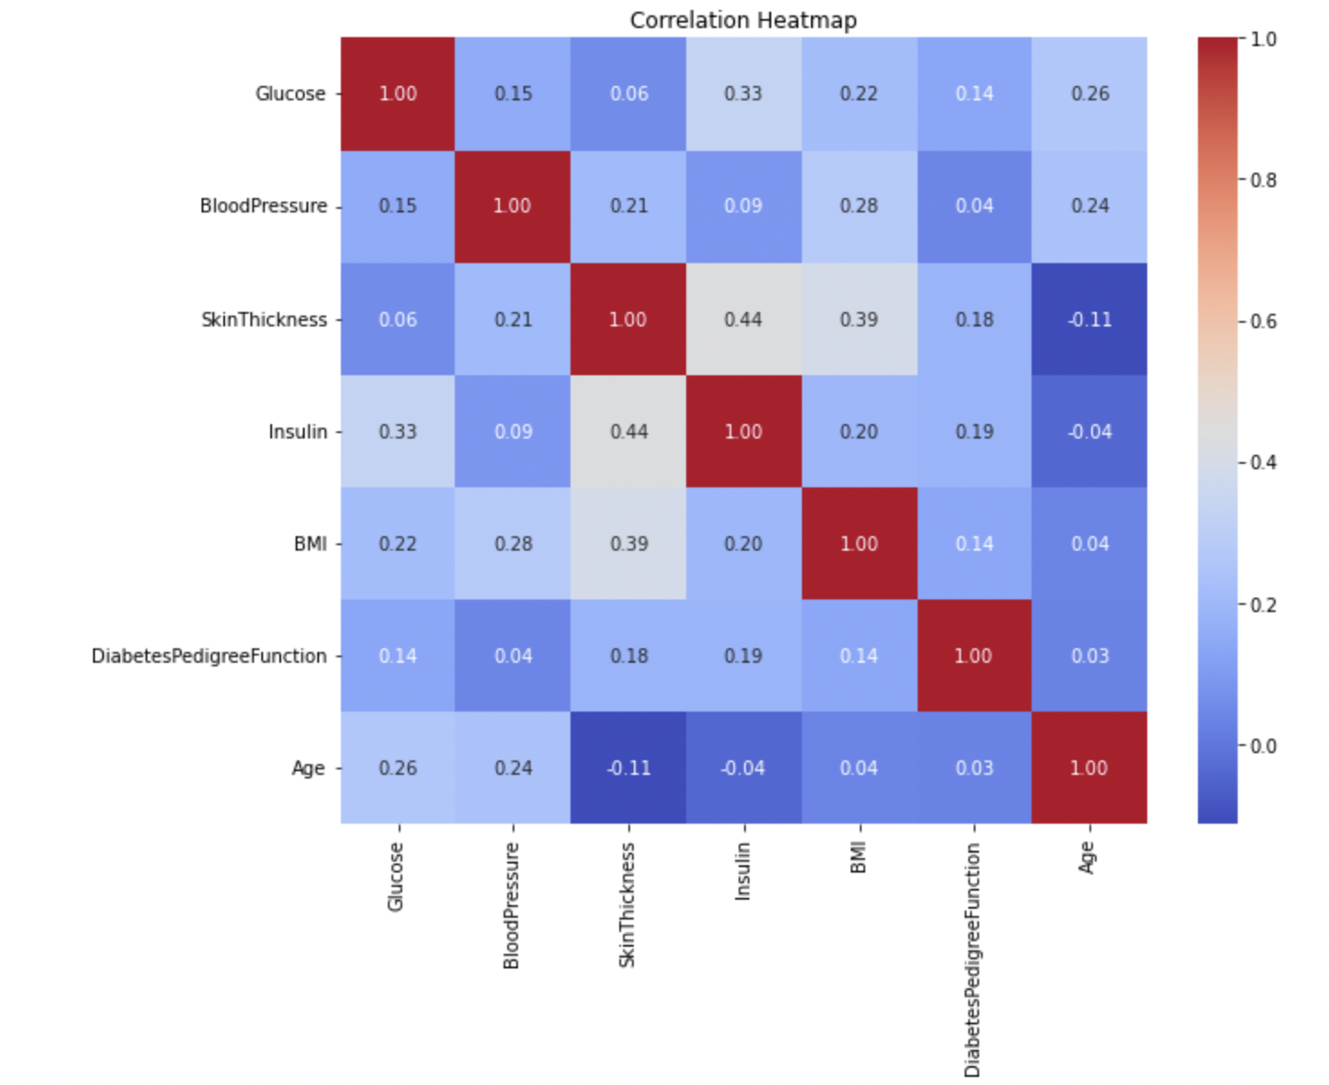
Heatmap analysis:
Glucose and Insulin: The heatmap shows a positive correlation between glucose levels and insulin levels. This suggests that patients with higher glucose levels may also have elevated insulin levels. The medication's impact on glucose levels could indirectly influence insulin levels as well.
Age and Diabetes Pedigree Function: The heatmap indicates a relatively weak positive correlation between age and diabetes pedigree function. This suggests that older patients might have a slightly higher diabetes pedigree function, potentially indicating a genetic predisposition to diabetes. The medication's effect on medication persistence might be influenced by genetic factors to some extent.
BMI (Body Mass Index) and Skin Thickness: There is a positive correlation between BMI and skin thickness. Patients with higher BMI values may also have thicker skin measurements. The medication's impact on BMI could indirectly influence skin thickness.
Blood Pressure and Other Features: The heatmap doesn't reveal strong correlations between blood pressure and other features. This implies that blood pressure might have a relatively independent relationship with medication persistence.

Slide 9
Conclusions from heatmap:
Recognizing the correlations between glucose and insulin levels could lead to interventions targeting both parameters for better medication adherence. Similarly, understanding the relationships between age, genetics, and diabetes pedigree function could inform personalized interventions for specific patient groups.

Slide 10
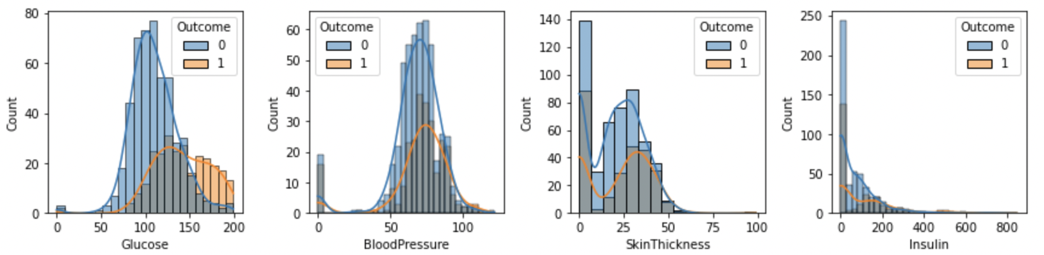
Histogram analysis:
Glucose Levels: The histograms indicate that patients with higher glucose levels tend to have a mix of both persistent (Outcome 1) and non-persistent (Outcome 0) medication adherence. This suggests that glucose levels alone might not be a strong predictor of medication persistence.
Blood Pressure: Blood pressure values are similarly distributed across both medication persistence outcomes, implying that blood pressure might not be a significant factor influencing medication adherence.
Skin Thickness: The histograms show that skin thickness values vary across both medication persistence outcomes, but the distribution patterns are relatively similar. Skin thickness might not have a substantial impact on medication adherence.
Insulin Levels: Insulin levels exhibit varied distributions for different medication persistence outcomes. Patients with higher insulin levels seem to have a mix of persistent and non-persistent adherence, indicating a potentially complex relationship.

Slide 11
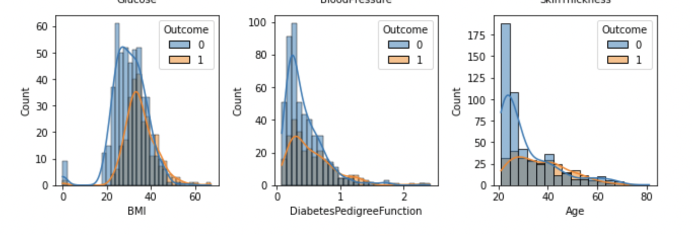
5. BMI (Body Mass Index): Patients with higher BMI values appear to be more persistent in medication adherence (Outcome 1). This suggests that individuals with higher BMI values might have a greater motivation to adhere to their prescribed medication regimen.
6. Diabetes Pedigree Function: The histograms show that diabetes pedigree function values have similar distributions for both outcomes. Genetic predisposition, as indicated by this feature, might not be a strong determinant of medication persistence.
7. Age: Age distributions are comparable for both medication persistence outcomes, suggesting that age alone might not be a significant factor influencing medication adherence.

Slide 12
Conclusions:
Some features show discernible differences between outcomes (e.g., BMI), others exhibit similar distributions regardless of medication adherence. This analysis aids ABC Pharma in identifying potential feature candidates that might play a pivotal role in predicting medication persistence.
By recognizing the impact of medication on specific features, ABC Pharma can tailor its strategies to improve patient outcomes. For instance, acknowledging the influence of BMI on medication adherence could lead to targeted interventions for individuals with higher BMI values. Similarly, understanding the distribution patterns of insulin levels might guide interventions aimed at patients with varying insulin requirements.

Slide 13
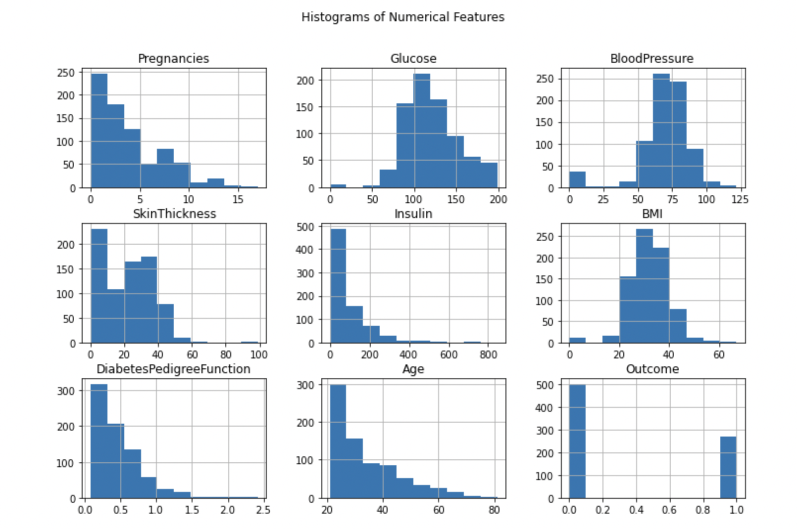
Overall Insights:
The visualizations provide valuable insights into the impact of medication persistence on both the distribution of outcomes and the relationships between medication adherence and physiological measurements.
Some features, such as Glucose Levels and BMI, seem to exhibit differences in distribution between medication persistence outcomes. These differences indicate potential correlations between medication adherence and certain physiological characteristics.
These histograms reveal insights into the spread and concentration of feature values. While some features exhibit distinct patterns (e.g., Age), others show more diverse distributions (e.g., Insulin Levels).

Slide 14
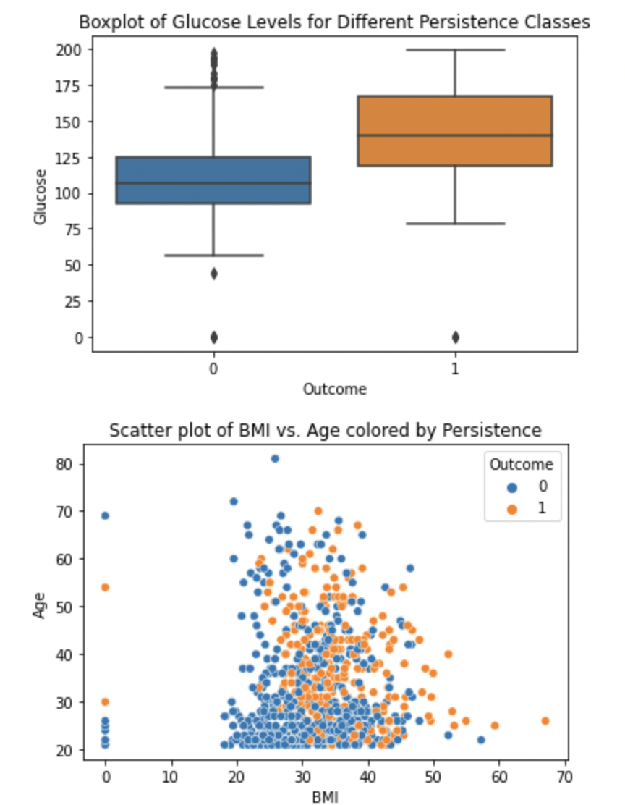
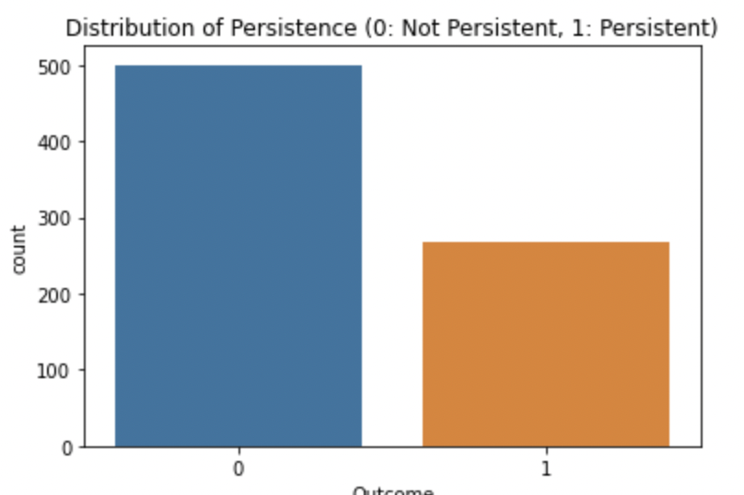
Patients with persistent medication adherence (Outcome 1) seem to have slightly higher median glucose levels compared to non-persistent patients (Outcome 0).
This visualization helps us observe the balance between the two outcomes and understand the proportion of patients in each category.
Recognizing the impact of glucose levels and BMI on medication persistence could lead to interventions that address these factors to improve adherence. Similarly, understanding the distribution of medication persistence outcomes guides ABC Pharma in identifying areas for potential improvement and intervention.
patients with higher BMI values tend to be more persistent in taking prescribed medications.

Slide 15
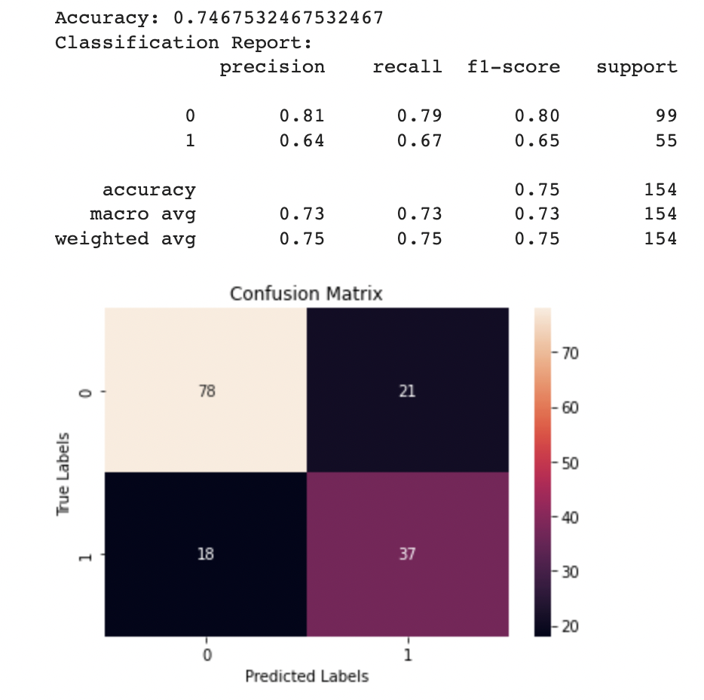
Summary of conclusions:
Accuracy: The accuracy of the model indicates the proportion of correctly classified instances. This metric gives an overall assessment of the model's predictive capability in differentiating between medication persistence outcomes.
Precision, Recall, and F1-Score: The classification report provides precision, recall, and F1-score for each medication persistence outcome. These metrics offer insights into the model's ability to correctly classify instances of each outcome while minimizing false positives and false negatives.
Confusion Matrix: The heatmap of the confusion matrix visualizes the true labels versus the predicted labels. It allows us to see where the model is making correct predictions and where it might be struggling. This visualization provides a deeper understanding of the model's performance across different medication persistence outcomes.
The model evaluation process provides a comprehensive assessment of the model's predictive performance and its impact on feature importance.
By analysing accuracy, precision, recall, and F1-score, ABC Pharma gains insights into how well the model predicts medication persistence based on physiological measurements.
Understanding the impact of the model on features helps ABC Pharma refine its strategies for enhancing medication adherence. For instance, if the model assigns higher importance to specific physiological measurements (e.g., Glucose Levels or BMI), ABC Pharma can focus on interventions that address these factors to improve patient outcomes.

Slide 16
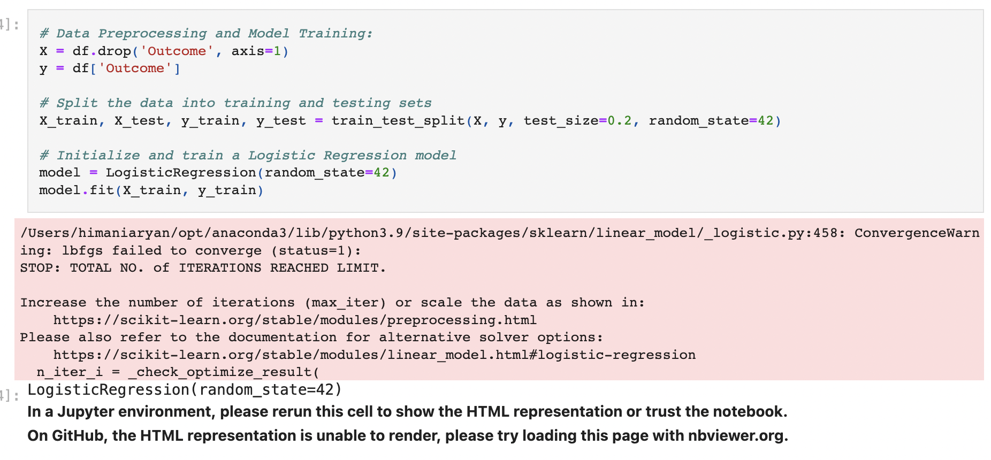
Existing modelling technique:
Logistic regression
Suggestion:
Replace the Logistic Regression, Decision Tree, and GridSearchCV models with a Random Forest Classifier. Adjust hyperparameters like n_estimators, max_depth, min_samples_split, and min_samples_leaf to optimize the model's performance.

Slide 17
Proposed Modelling technique:
Random Forest Classification
from sklearn.ensemble import RandomForestClassifier
By implementing Random Forest Classification, ABC Pharma can gain a deeper understanding of the impact of physiological measurements on medication persistence.

Slide 18
Thank you.

